Slide 1

From real estate data to a House for Larry Sanders
Matching Business offers to Client Preferences through EDA
(Exploratory Data Analysis)

Slide 2


Larry Sanders Buyer
Waterfront
limited budget
nice & isolated
central neighborhood without kids
Larry got some kids of his own, just doesn't want his kids to play with other kids … because of germs

Slide 3

Hypotheses to be tested
Hypotheses 1:
Hypotheses 2:
Hypotheses 3:
Houses at the waterfront have rarely a basement
Houses at the waterfront have more squarefeet (are larger)
Houses at the waterfront are the most expensive

Slide 4
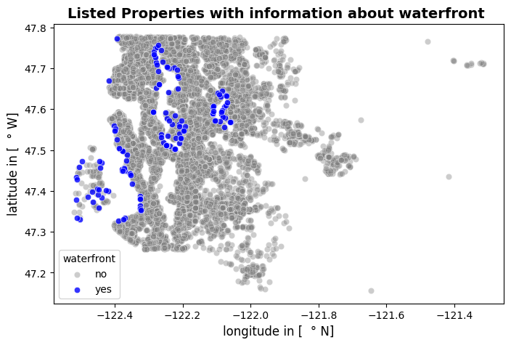
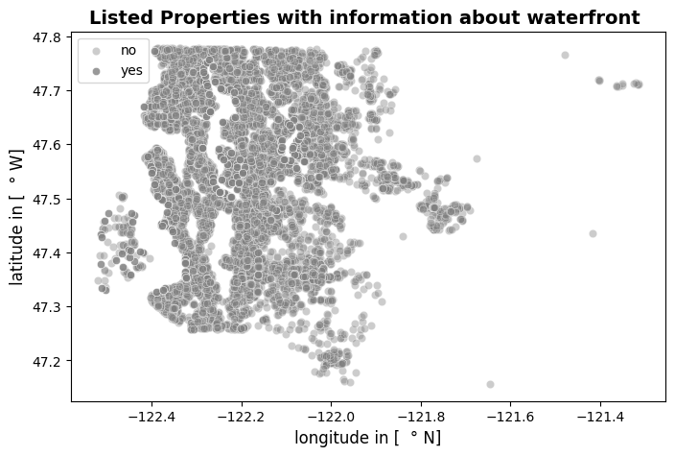
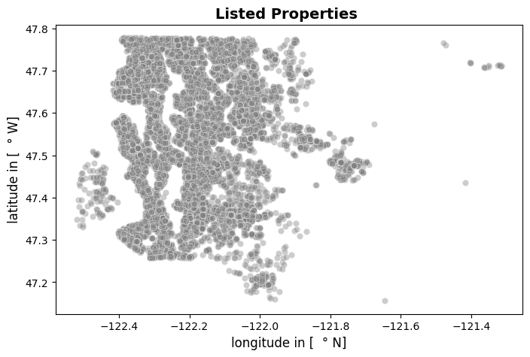
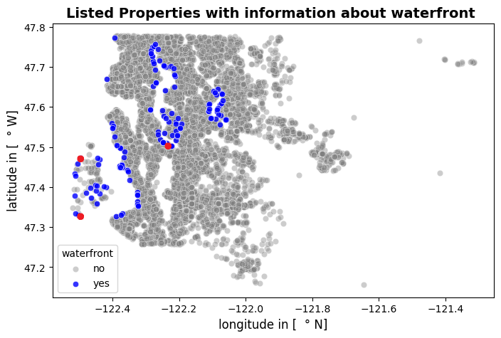
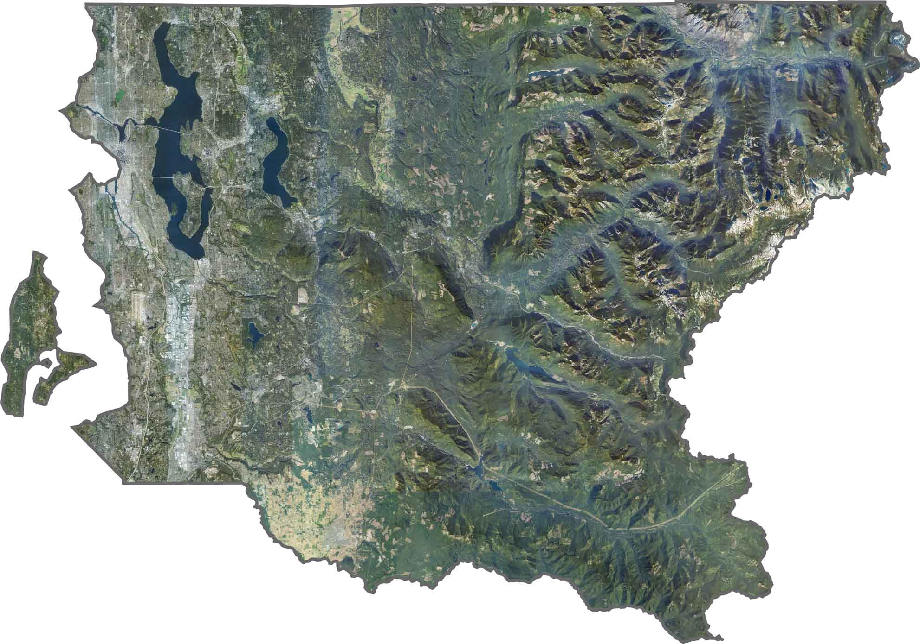
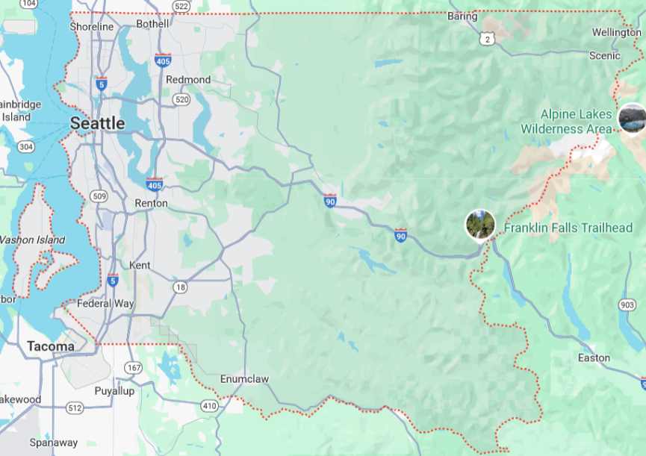
Real estate in King County
map of King county:

Slide 5
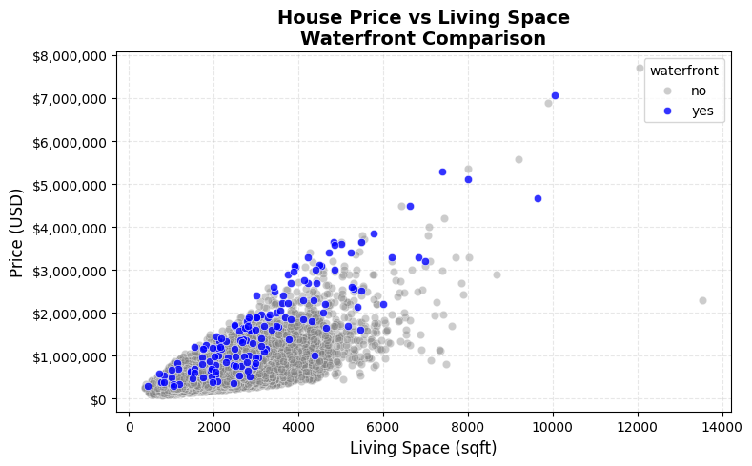
Hypothese 1: Houses at the waterfront have more squarefeet
Hypotheses 1: confirmed for > 3000 sqft

Slide 6
Hypothese 2: Houses at the waterfront rarely have a basement
 | has no basement |  | has basement
no waterfront | 411 houses | 2.156 % | 18649 houses | 97.844 %
at waterfront | 4 houses | 2.740 % | 142 houses | 97.260 %
There is no connection between basements and the waterfront location
Hypotheses 3 refuted

Slide 7
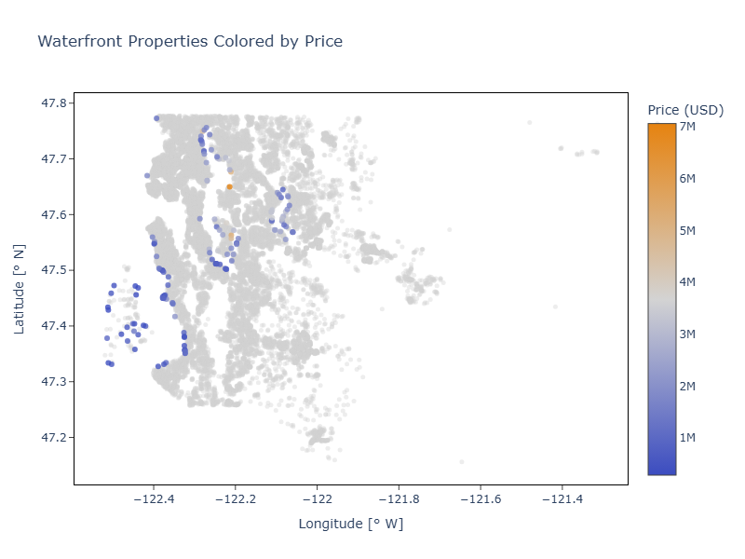
Hypothese 3: houses that are isolated and at the waterfront are the most expensive
There is no connection between isolation in connection with location at the waterfront and price
Hypotheses 3 refuted

Slide 8
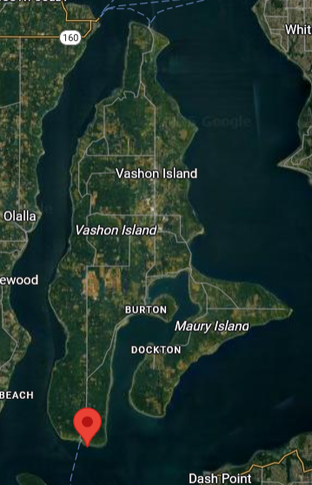
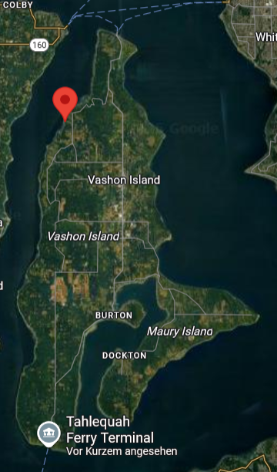
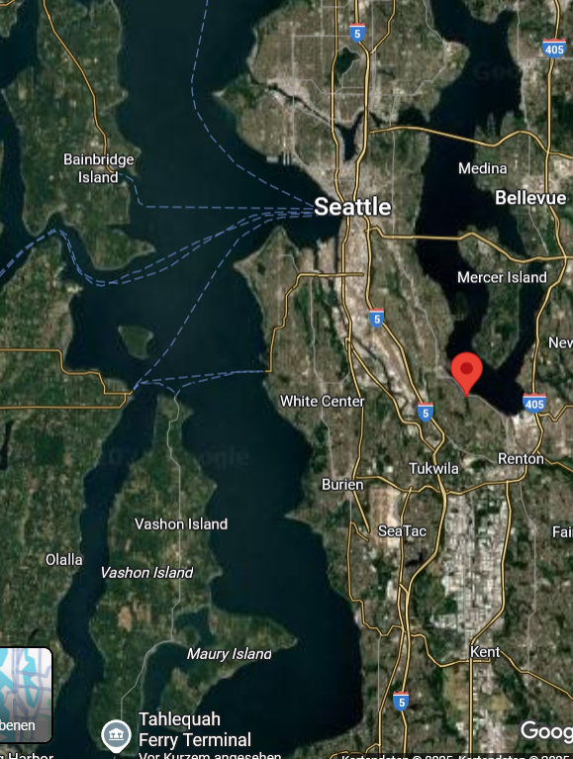
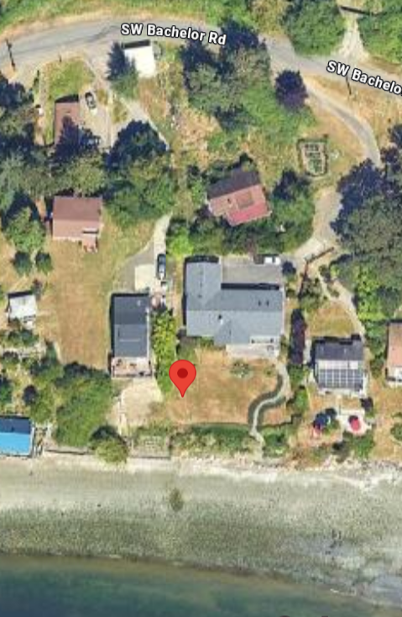
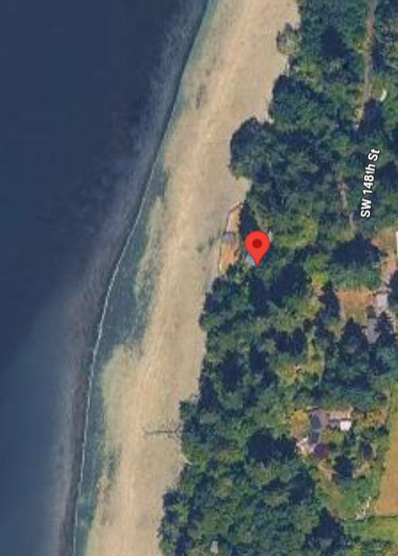
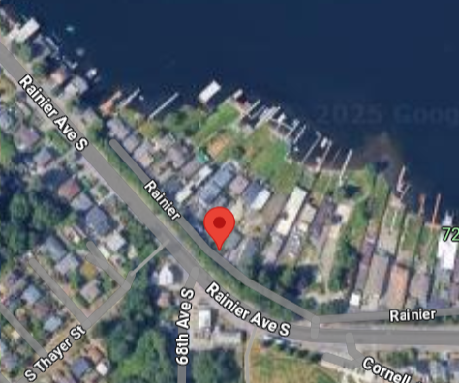
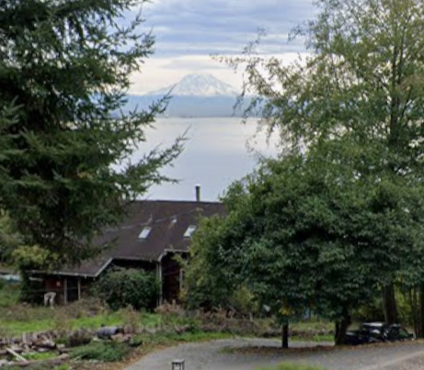
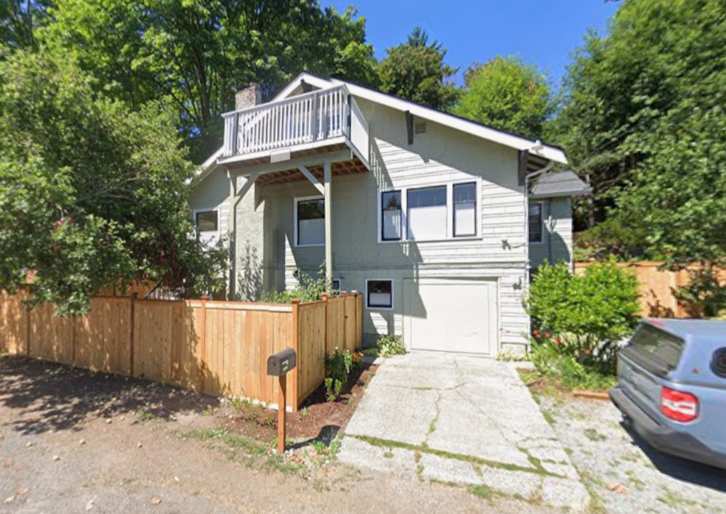
House Recommendations
Recommendation 1
Recommendation 2
Recommendation 3
47.331194, -122.503
2034sqft
549000$
47.5117, -122.248
1160sqft
700000$
47.4728, -122.497
1494sqft
465000$

